Slide 1
Quiz on Lecture 8
Please receive the quiz handout from Cyrille, Oliver, Vincent, Jan
Complete the quiz in silence
Hand the quiz back

Slide 2
Quiz on Lecture 8
What concept in Dagster brings all other concepts together?
  Definitions
  Asset Checks
  Assets
  IO Manager
What can Dagster be used for?
  Only Data Engineering projects
  Only Data Science projects
  Any project that involves working with data
  Only MLOps projects
The following are frameworks for building DAGs
  Azure DAGflow, Apache Lakeflow
  AWS dagflow, dagster
  Palantir Foundry, dagster
  Apache Lakeflow, GCP Dataplex
  Aubergine, Apple, Eggplant
What is the concept of a Dagster "job"?
  a logical unit of data
  a group of "Definitions"
  a way to automate running assets
  a subset of assets
  none of the above
In Dagster, what is used to abstract away connections to external services like databases or APIs?
  Resources
  Executors
  Sensors
  IO Managers
What is dg.AssetExecutionContext doing in the following code:
def raw_data(
context: dg.AssetExecutionContext,
) -> dg.MaterializeResult:
  dg.AssetExecutionContext is type-hinting for context. If dg.AssetExecutionContext is removed, the code will run the same as before.
  dg.AssetExecutionContext provides access to system information like loggers and the current run ID
  dg.AssetExecutionContext passes the runtime state between assets
  dg.AssetExecutionContext is the context runtime that forms the logic for the state between assets

Slide 3
Quiz on Lecture 8 (answers)
What concept in Dagster brings all other concepts together?
  Definitions
  Asset Checks
  Assets
  IO Manager
What can Dagster be used for?
  Only Data Engineering projects
  Only Data Science projects
  Any project that involves working with data
  Only MLOps projects
The following are frameworks for building DAGs
  Azure DAGflow, Apache Lakeflow
  AWS dagflow, dagster
  Palantir Foundry, dagster
  Apache Lakeflow, GCP Dataplex
  Aubergine, Apple, Eggplant
What is the concept of a Dagster "job"?
  a logical unit of data
  a group of "Definitions"
  a way to automate running assets
  a subset of assets
  none of the above
In Dagster, what is used to abstract away connections to external services like databases or APIs?
  Resources
  Executors
  Sensors
  IO Managers
What is dg.AssetExecutionContext doing in the following code:
def raw_data(
context: dg.AssetExecutionContext,
) -> dg.MaterializeResult:
  dg.AssetExecutionContext is type-hinting for context. If dg.AssetExecutionContext is removed, the code will run the same as before.
  dg.AssetExecutionContext provides access to system information like loggers and the current run ID
  dg.AssetExecutionContext passes the runtime state between assets
  dg.AssetExecutionContext is the context runtime that forms the logic for the state between assets

Slide 4
Designing and Deploying
end-to-end
Production Grade ML Applications
Lecture 9 : End to End ML Lifecycle
October 2025
Cyrille Feudjio & Oliver Angélil

Slide 5
Contents of this lecture
Overview: What is the ML lifecycle?
Problem Framing & Scoping
Data Acquisition
Data Cleaning & Preprocessing
Exploratory Data Analysis (EDA)
Feature Engineering & Selection
Model Development, Validation & Hyperparameter Tuning
Deployment & Serving
Monitoring, Maintenance & Drift Detection
Conclusion & Key Takeaways

Slide 6
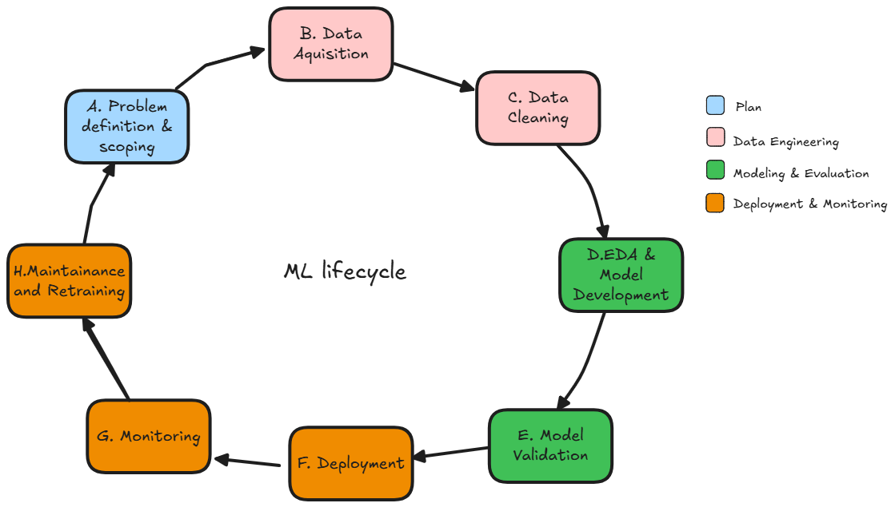
1. Overview: What is the ML lifecycle?
Definition: A structured, iterative process for delivering machine learning solutions

Slide 7
2. Problem Framing & Scoping
2.1. Define the Core Business Objective and Desired Outcome
Begin by clearly stating why this project is being initiated. What problem are you trying to solve, and what value does it bring to the business? The objective should be specific, measurable, and aligned with organizational goals.
Example:
Bad: Reduce customer churn using machine learning.
Good: Develop a predictive model to identify customers at high risk of churn within the next 30 days, with the goal of reducing monthly churn rate by 15% over the next two quarters.

Slide 8
2. Problem Framing & Scoping
2.2. Identify Key Profiles
List all individuals or teams involved or impacted by the project. This may include:
Data Scientists/Engineers who will build and deploy the solution
Product Managers who define user needs and ensure alignment with product strategy
Domain Experts who bring deep industry or process knowledge
End Users who will interact with the final product or benefit from the output
Example:
Data Science Team (Model development & evaluation)
Marketing Department (Uses model predictions for retention campaigns)
Customer Success Managers (Feedback on customer behavior and churn signals)

Slide 9
2. Problem Framing & Scoping
2.3. Specify Success Criteria and Evaluation Metrics
Define how success will be measured both from a technical and business perspective. Include relevant KPIs and performance benchmarks.
Technical Metrics Examples:
Model accuracy, precision, recall, F1-score
Area Under ROC Curve (AUC-ROC)
Business Metrics Examples:
% reduction in churn rate
Increase in Customer Lifetime Value (CLV)
Example: A model is considered successful if it achieves at least 85% precision and recall on the validation set, and leads to a 10% increase in CLV.

Slide 10
2. Problem Framing & Scoping
2.4. Outline Project Scope, Constraints, and Assumptions
Clearly define what will and will not be included in the project. Be explicit about:
Data sources: Internal Customer Relationship Management (CRM) data; transaction logs; demographics data (e.g. location, age)
Timeline: Milestones, deadlines
Example: Scope includes developing a binary churn prediction model for North American customers using data from the last 12 months. The project does not include deployment or international expansion.

Slide 11
2. Problem Framing & Scoping
2.5. Assess Risks, Ethical Considerations, and Data Availability
Highlight potential issues that could affect project success and how they will be mitigated.
Risks
Incomplete or biased data
Overfitting or poor model generalization
Ethical Considerations & Data Availability
Data privacy and consent
Potential biases in model predictions
Confirm whether data is accessible, clean, and compliant with privacy regulations
Example of risk: Model might incorrectly flag loyal customers as churn risks.

Slide 12
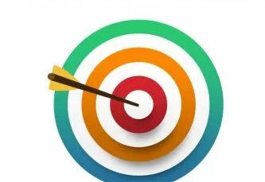
Exercise
Scenario
You are a data science consultant hired by a municipal transportation department to help reduce traffic congestion in a growing city. The city has installed traffic sensors at major intersections, collected historical GPS data from public buses, and conducted periodic traffic surveys. You are tasked with scoping a data science project to support real-time traffic management and congestion forecasting.
Complete the following project scoping steps:
Define the core business objective and desired outcome
Identify key profiles
Specify success criteria and evaluation metrics
Outline the project scope, constraints, and assumptions
Assess risks, ethical considerations, and data availability

Slide 13
Exercise (solutions)
Define the core business objective and desired outcome
  Reduce traffic congestion by developing a predictive system that uses traffic sensors, GPS data, and surveys to forecast congestion at key intersections 30–45 minutes in advance, enabling the transportation department to optimize traffic lights, adjust bus routes, and provide real-time updates to drivers.
Identify key profiles
  Data Science Team: Responsible for building, testing, and validating the models.
  Traffic Engineers: Provide domain expertise on traffic flow dynamics and validate model outputs.
  City IT Department: Ensures integration with existing traffic management systems.
  Public Transportation Managers: Use predictions to optimize bus routes and schedules.
  City Policy Planners – Use insights for long-term infrastructure planning.

Slide 14
Exercise (solutions)
Specify success criteria and evaluation metrics
Technical Metrics
  Prediction accuracy of congestion levels ( 85%+ accuracy within 30-minute forecasts)
  Latency of real-time system (<5 seconds from data ingestion to prediction)
Business Metrics:
  15% reduction in average travel time on main corridors during peak hours
  Improved on-time arrival rates of public buses by 20%
  Increase in satisfaction scores in surveys.
Outline the project scope, constraints, and assumptions
  Develop, test and deploy a congestion forecasting system that use traffic sensor, GPS, and survey data to provides real-time traffic predictions to the transportation department
  Project timeline: 6 months for initial prototype
  Must work with existing city servers
  Data from sensors, buses, and surveys is accessible, sufficient, and can be integrated.
  The initial system will focus on the busiest 20 intersections.

Slide 15
Exercise (solutions)
Assess risks, ethical considerations, and data availability
Risks:
  Incomplete or noisy sensor data may reduce prediction accuracy
  Overfitting if the model only captures historical traffic patterns but fails in unexpected events (accidents, road work)
  Resistance from city staff in adopting new technology
Ethical Considerations:
  Data complies with municipal privacy regulations
Data Availability:
  Traffic sensor data is available but requires preprocessing for consistency
  GPS data from buses is comprehensive but may contain missing points
  Survey data is periodic and useful for calibration but not real-time

Slide 16
3. Data Acquisition
Effective Data acquisition is the critical first steps in any data-driven workflow. Without a solid foundation here, any subsequent analysis or modeling is compromised. it's the principle of "garbage in, garbage out."
Data Ingestion: The process of collecting or sourcing raw data from a wide variety of origins.
Data Transformation & Modeling : The practice of organizing, storing, and maintaining the acquired data throughout its lifecycle
Note that Modeling can mean Modeling in DE (e.g. Star Schema / Kimball) or Modeling in ML (e.g. statistical model).
Here we mean the modeling in DE.

Slide 17
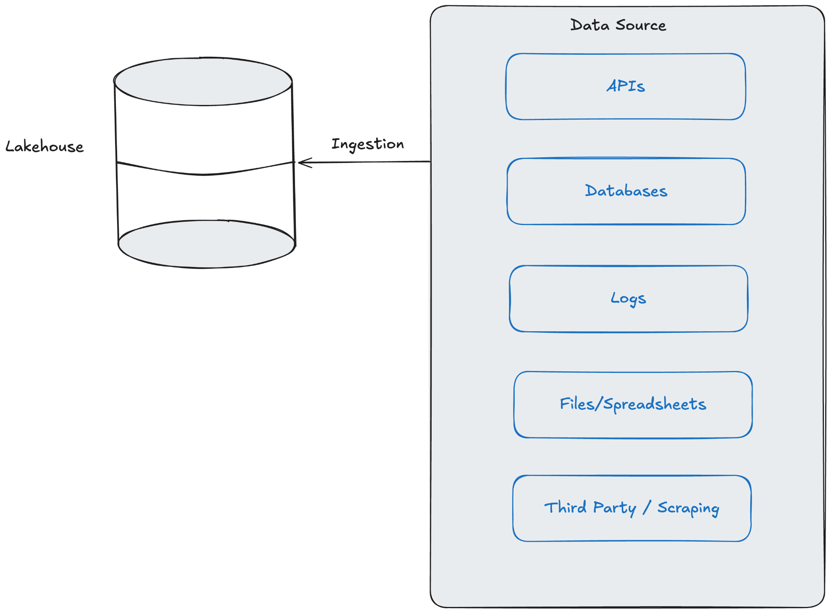
3. Data Acquisition

Slide 18
4. Data Cleaning & Preprocessing
Raw data is often messy, inconsistent, and incomplete. This stage is arguably the most critical and time consuming part of a data project, as the quality of your output is entirely dependent on the quality of your input.
Real-world data is dirty. Before analysis or modeling, we must fix fundamental issues to ensure our results are accurate and reliable.
Data Cleaning: The process of detecting and correcting inaccurate, incomplete, or irrelevant records from a dataset.
df = df.drop_duplicates() # Remove duplicate rows
df["Name"] = df["Name"].fillna("Unknown") # Handle missing names
df["Age"] = df["Age"].apply(lambda x: None if x < 0 else x) # Fix invalid ages

Slide 19
4. Data Cleaning & Preprocessing
Data Preprocessing: A broader set of operations to transform and reformat data into a suitable state for a machine learning model.
df_spatial_mean: pd.DataFrame = raw_pandas_df.groupby('time')['t2m'].mean().reset_index()
context.log.info("Aggregated multiple lat/lon points by averaging 't2m' per timestamp.")
num_time_steps = len(df_spatial_mean)
mean_temp_kelvin = df_spatial_mean['t2m'].mean()
See the full code here

Slide 20
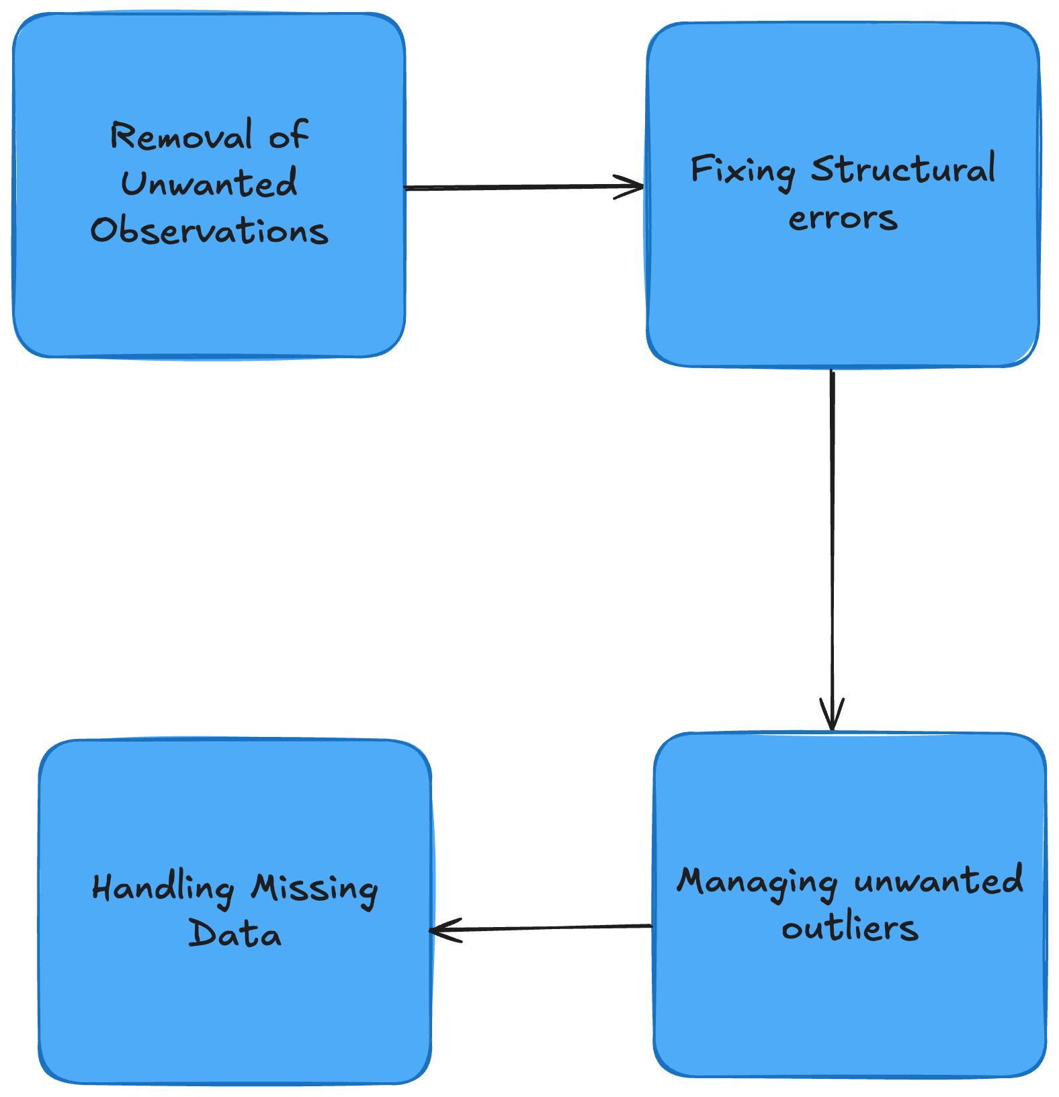
4. Data Cleaning & Preprocessing
Handling Missing Values: Impute, drop, or flag nulls based on data patterns
Outlier Detection & Treatment: Use statistical thresholds or domain logic to remove or cap extreme values
Encoding & Normalization: Convert categorical variables (e.g., one-hot, label encoding), and scale numeric features (e.g., MinMax, Z-score)
Date Processing: extract features from timestamps (e.g., day of week, time since last login)

Slide 21
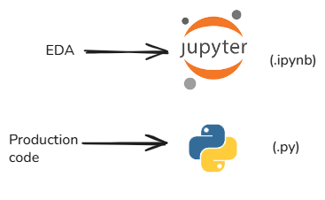
5. Exploratory Data Analysis (EDA)
What is EDA?
  Initial investigation to understand data characteristics, patterns, and potential issues.
  Heavily relies on visualization and summary statistics.
Key Activities:
  Calculate descriptive statistics (mean, median, standard deviation, counts).
  Visualize data distributions (histograms, box plots, density plots).
  Explore relationships between variables (scatter plots, correlation matrices).
  Identify missing values, outliers.
  Uncover patterns, trends, and initial insights.
Purpose & Outcome:
  Gain deep data understanding.
  Guide feature engineering and selection.
  Validate data quality.
  Generate hypotheses for modeling.
Note that all of this is usually done in jupyter notebooks.
What we do in this course is not EDA. It is what comes after EDA.

Slide 22
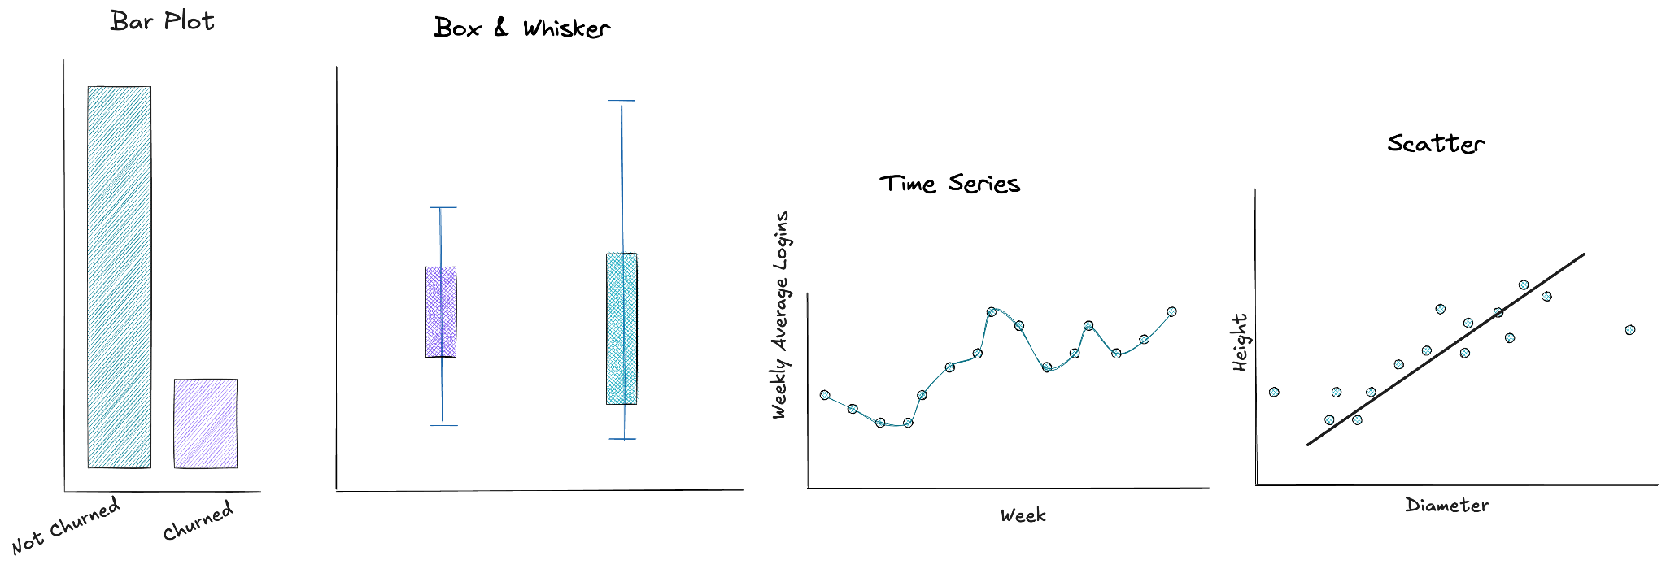
5. Exploratory Data Analysis (EDA)
Every type of figure, fulfills a specific purpose!
-> visualise total count
-> visualise a distribution.
Other ways: histogram; Cumulative Distribution Function (CDF), etc
-> visualise change as a function of time
-> visualise correlation between two variables

Slide 23
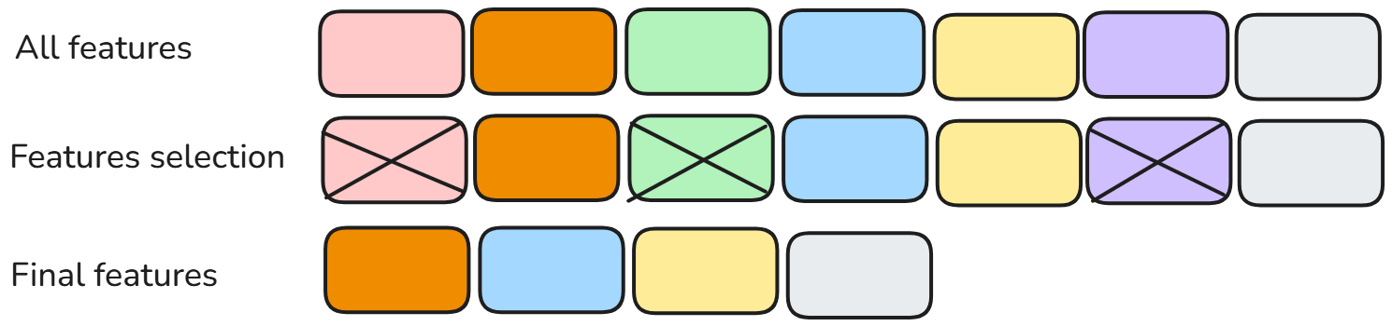
6. Feature Engineering & Selection
While data cleaning gets our data into a usable state, feature engineering is where we can be creative and significantly boost model performance. It’s about making the patterns in the data more apparent to our algorithms.
Feature Engineering: The art of creating new features from existing data using domain knowledge. The goal is to better represent the underlying problem to the predictive models
Feature Selection: The science of selecting the most relevant features from the available set. The goal is to reduce noise and reduce computational cost.

Slide 24
6. Feature Engineering & Selection
# Feature Engineering: Create a lagged temperature feature
lag_period = 1
df_with_lag = clean_df.copy()
feature_name = f"t2m_celsius_lag{lag_period}"
df_with_lag[feature_name] = df_with_lag["t2m_celsius"].shift(lag_period)
df_with_lag = df_with_lag.dropna().reset_index(drop=True)
feature_names = [feature_name]
See the full code here

Slide 25
7. Model Development, Validation & Hyperparameter Tuning
Model Development:
The core phase of selecting or building the machine learning model.
Choosing the right algorithm based on problem type (classification, regression, clustering, etc.), data characteristics, and project requirements.
Initial model training on the prepared data (using the training dataset)
Hyperparameter Tuning:
Optimizing model performance by adjusting hyperparameters that control the learning process.
Enhance the model's ability to generalize to unseen data.
Validation Strategies:
Train/Test Split: Simplest. Split data (e.g., 80/20); train on one, evaluate on the other. Sensitive to split randomness.
Cross-Validation (k-Fold): More robust. Split data into k folds; train on k-1, test on 1, rotate & average results. Better data utilization.

Slide 26
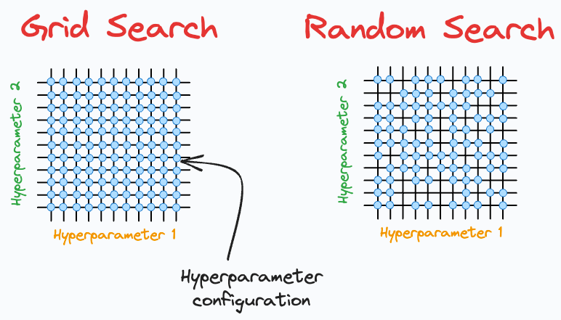
7. Model Development, Validation & Hyperparameter Tuning
Hyperparameter Tuning
Grid Search
Exhaustively tries all combinations in the specified parameter grid.
Pros: Simple, guaranteed to find the best combination within the grid.
Cons: Computationally expensive for large search spaces.
Random Search
Samples random combinations from the search space.
Pros: Faster for large search spaces.
Cons: Might miss the exact best parameters.
imagine it takes 1 hour to train a model and you have set
20 different hyperparameter configurations to run through your model.

Slide 27
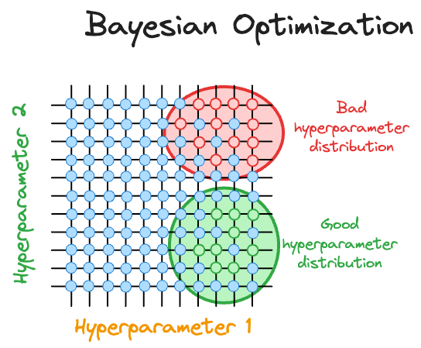
7. Model Development, validation & Hyperparameter Tuning
Hyperparameter Tuning
Bayesian optimization
While iterating over different hyperparameter configurations, the Bayesian optimization algorithm constantly updates its beliefs about the distribution of hyperparameters by observing model performance corresponding to each hyperparameter. This allows it to take informed steps to select the next set of hyperparameters, gradually converging to an optimal set of hyperparameters.
See an example code here

Slide 28

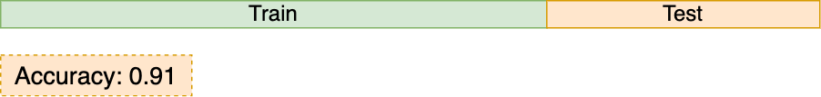
7. Model Development, Validation & Hyperparameter Tuning
Train/Test Split
Performance estimates are highly dependent on the test set. An easy set can cause an unrealistically high evaluation, while a difficult one can lead to an unrealistically low view of the model's ability to generalize.
from sklearn.model_selection import train_test_split
from sklearn.ensemble import RandomForestClassifier
from sklearn.metrics import accuracy_score
# split in train and test
X_train, X_test, y_train, y_test = train_test_split(X, y, test_size=0.2, random_state=0)
clf = RandomForestClassifier(n_estimators=2, random_state=0)
clf.fit(X_train, y_train)
# test with unseen data
y_pred = clf.predict(X_test)
acc = accuracy_score(y_test, y_pred)

Slide 29
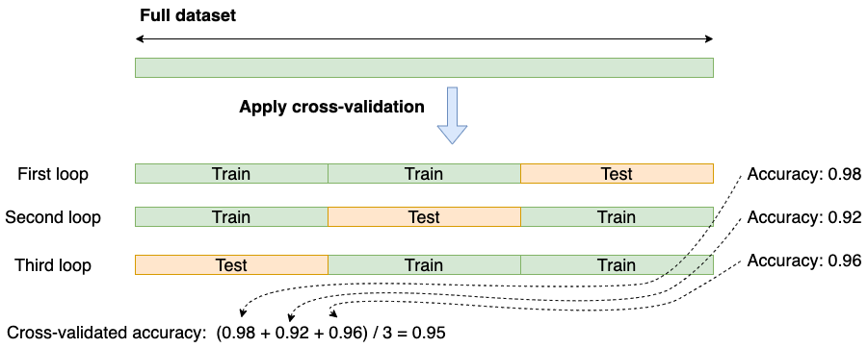
7. Model Development, Validation & Hyperparameter Tuning
Cross-Validation (k-Fold)
This solves the problem of an unreliable performance metric, but it introduces another challenge: we're evaluating a model with arbitrary hyperparameters. What's the right way to find the best hyperparameters without letting that search process bias our final performance score?
from sklearn.model_selection import cross_val_score, KFold
from sklearn.ensemble import RandomForestClassifier
clf = RandomForestClassifier(n_estimators=2, random_state=0)
# Set up the cross-validation strategy shuffle=True is good practice to randomize the data
cv = KFold(n_splits=3, shuffle=True, random_state=0)
# 3. Perform cross-validation
# cross_val_score will handle the splitting, training, and testing for each of the 3 folds.
# It returns an array of scores.
scores = cross_val_score(clf, X, y, cv=cv, scoring='accuracy')

Slide 30
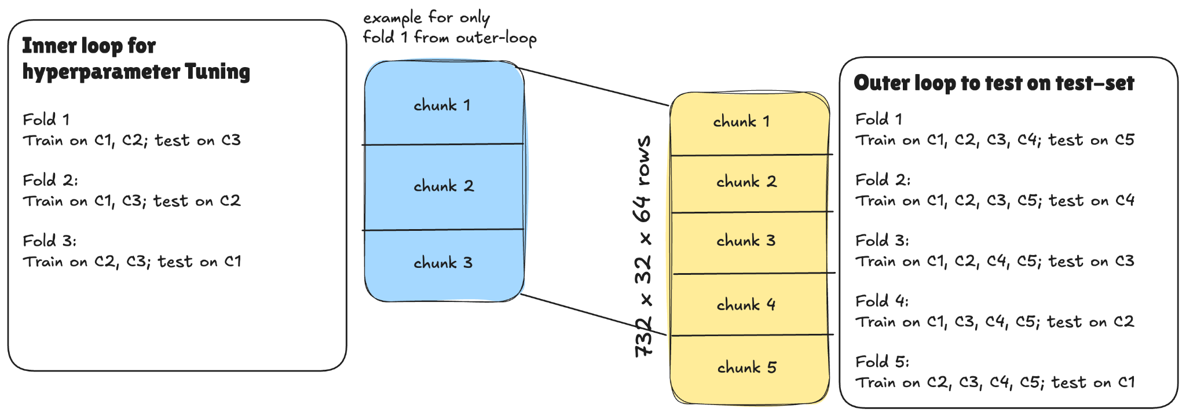
7. Model Development, Validation & Hyperparameter Tuning
Nested Cross-Validation
This is a more accurate method for estimating the performance while also optimizing hyperparameters

Slide 31
7. Model Development, Validation & Hyperparameter Tuning
Nested Cross-Validation
Outer Loop (Model Evaluation):
  The entire dataset is split into training and testing folds .
  In each iteration, one fold is held back as the final test set. This set is not touched until the very end of the iteration.
  The remaining folds are passed to the inner loop as the training set.
Inner Loop (Hyperparameter Tuning):
  This loop works only with the training data provided by the outer loop.
  It performs its own cross-validation (3-fold CV) on this subset of data to find the optimal hyperparameters.
  The best hyperparameters are identified based on the average performance across the inner folds.
Final Evaluation:
  The best hyperparameters found by the inner loop are used to train a new model on the entire training set from the outer loop.
  This final model is then scored against the held-out test set from the outer loop.
  This process is repeated for all folds of the outer loop, and the resulting scores are averaged to get a final performance estimate.

Slide 32
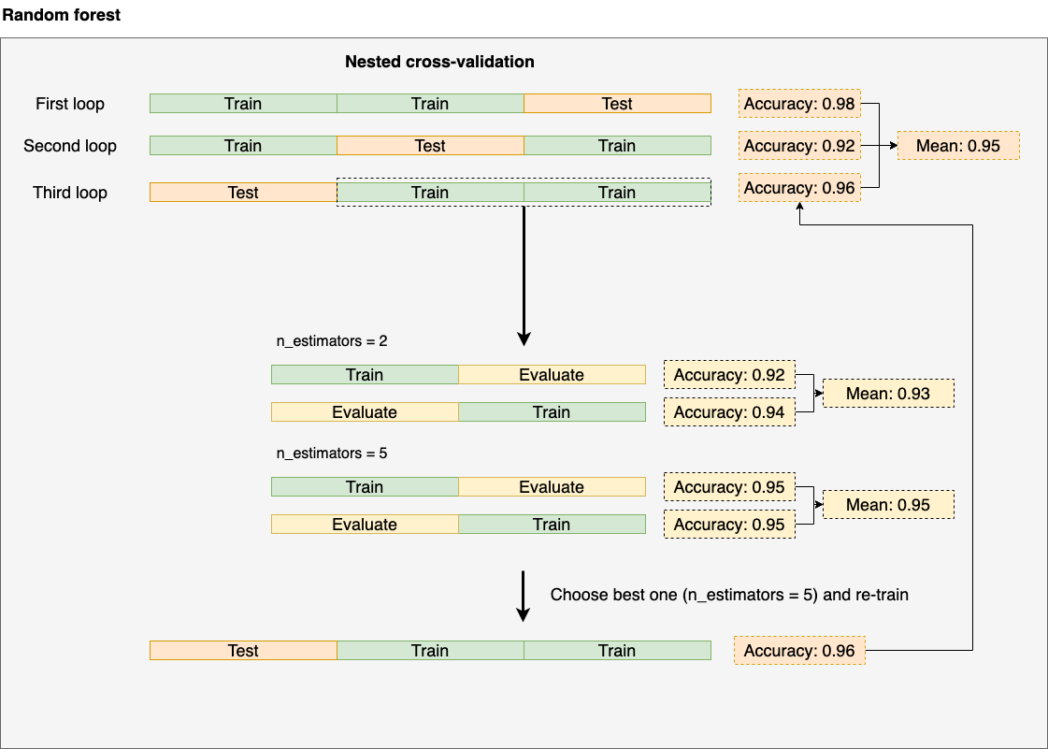
7. Model Development, Validation & Hyperparameter Tuning
Nested Cross-Validation

Slide 33
7. Model Development, Validation & Hyperparameter Tuning
Nested Cross-Validation
from sklearn.model_selection import cross_val_score, KFold, GridSearchCV
from sklearn.ensemble import RandomForestClassifier
clf = RandomForestClassifier(random_state=0)
# Define the hyperparameter grid to search
p_grid = {
"n_estimators": [10, 50, 100, 200]
}
# Set up the cross-validation splitters for outer and inner loops
outer_cv = KFold(
n_splits=5, shuffle=True, random_state=1
)
inner_cv = KFold(
n_splits=3, shuffle=True, random_state=2
)
# Set up the inner loop: Grid Search for hyperparameter tuning
grid_search = GridSearchCV(
estimator=clf,
param_grid=p_grid,
cv=inner_cv,
scoring='accuracy'
)
# Perform the nested cross-validation. We pass the GridSearchCV object as the estimator to cross_val_score.
nested_scores = cross_val_score(
estimator=grid_search,
X=X,
y=y,
cv=outer_cv,
scoring='accuracy'
)

Slide 34
8. Deployment & Serving
Deployment & Serving refers to the phase where a trained model is made available for use in real-world applications, so it can receive inputs and return predictions.
Deployment
The process of integrating the trained model into a production environment.
This could mean:
  Embedding it into a web or mobile app
  Exposing it via an API
  Running it as part of a batch processing pipeline
Serving
The act of providing the model’s predictions to end-users or other systems.
Typically involves:
  Accepting input data
  Running inference (prediction) with the model
  Returning results

Slide 35
8. Deployment & Serving
8.1. Types of Model Serving
Batch Serving
In batch serving, the model processes a large volume of data all at once on a predetermined schedule (e.g., hourly, daily, or weekly). This is the most cost-effective method when you don't need instant results.
Use this when: Predictions are not needed immediately and can be calculated in advance
Trigger: A fixed schedule
Example: A retail company wants to identify customers who are likely to churn. Every Sunday night, a model runs on the week's sales data to generate a list of at-risk customers. The marketing team then uses this list to plan their campaigns for the upcoming week

Slide 36
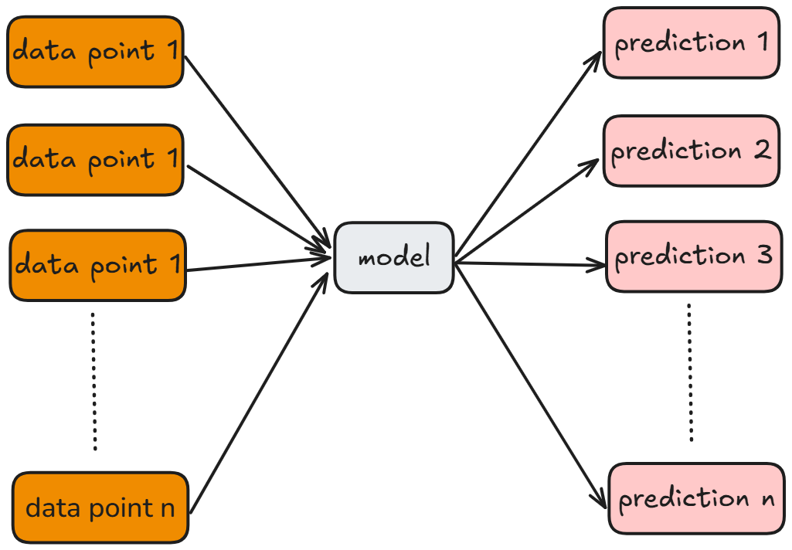
8. Deployment & Serving
Batch Serving
Runs predictions on large datasets in bulk, usually at scheduled times
Data is collected and processed together
Best for use cases without strict latency: daily reports, historical analysis, periodic processing

Slide 37
8. Deployment & Serving
Real Time Serving
Real-time serving generates predictions on demand, typically for a single input at a time, and delivers them instantly.
Use this when: You need an immediate prediction to support a real-time decision
Trigger: A user action or a direct request from another system
Example: When you use a ride sharing app, you enter your destination and instantly get a price estimate. A real-time model takes your request and immediately calculates the predicted fare based on traffic, distance, and current demand

Slide 38
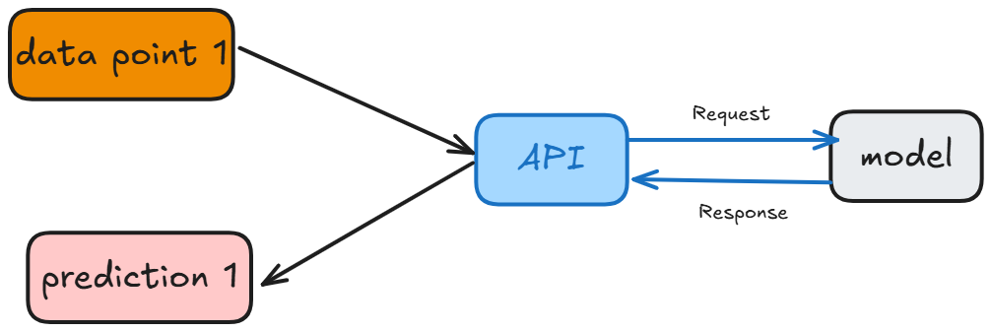
8. Deployment & Serving
Real Time Serving
Serves predictions instantly through an API when input is received.
Each request gets an immediate response from the model.
Best for: chatbots, recommendations …

Slide 39
8. Deployment & Serving
Streaming Serving
Streaming serving is used when data arrives in a continuous flow. The model processes these events as they come in, providing near real-time predictions on an ongoing basis
Use this when: You need to continuously monitor and make predictions on a constant stream of new data
Trigger: A continuous flow of data
Example: A factory uses sensors to monitor its equipment. A streaming model analyzes this sensor data as it's generated to predict potential machine failures before they happen, allowing for preventative maintenance

Slide 40
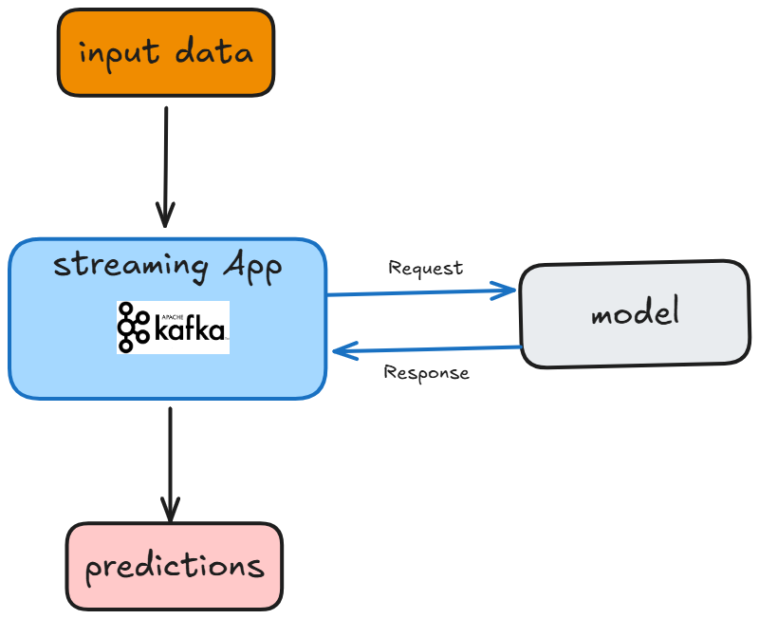
8. Deployment & Serving
Streaming
Processes continuous data streams in near real-time.
Model consumes events as they arrive
Best for: IoT sensor monitoring, live anomaly detection, traffic management.
Data are usually ingested from sources such as Apache Kafka, processed by a deployed model, and predictions are outputted back into Kafka for further downstream processing or action.

Slide 41
9. Monitoring, Maintenance & Drift Detection
Monitoring: Once a model is in production, you must continuously track its performance:
Track model's business outcomes
Monitor model performance metrics
Monitor system metrics (latency, errors, resource usage).
Tools: Prometheus, Grafana, Evidently AI, AWS CloudWatch …
Maintenance: Models degrade over time due to:
Changes in data
New business requirements
Maintenance includes:
Scheduled retraining on fresh data.
Feature updates (adding/removing features).
Hyperparameter re-tuning.

Slide 42
9. Monitoring, Maintenance & Drift Detection
Drift is the natural degradation of a model's predictive power over time because the real-world environment changes, making the original training data obsolete.
Analogy
Imagine it's 2020, and we build a machine learning model to predict whether a new AIMS student will pursue a career in academia (Ph.D., research) or industry. We train this model on data from all AIMS South Africa graduates from 2010 to 2019. The model learns the patterns from that decade and is very accurate.
Now, we fast-forward to 2025 and use the same model on the current class. We find that its predictions are frequently wrong. The model's performance has degraded. This decline in accuracy because the world has changed is called drift.
There are two primary types of drift

Slide 43
9. Monitoring, Maintenance & Drift Detection
Data Drift : This happens when the distribution of the input data changes, even if the underlying meaning remains the same. In other words, the input data is different from what the model was trained on
Analogy
In 2010-2019 (Training Data): The majority of AIMS students came from a pure mathematics or theoretical physics background. Our model learned that this type of profile was a strong predictor of a future in academia.
By 2025 (New Data): AIMS has become famous for its data science program. The new student cohort has a much higher percentage of students with backgrounds in computer science, statistics, and engineering.
The model now sees all these new student profiles that it has little experience with. Because the distribution of student backgrounds has changed so much, its old patterns no longer apply well, and its predictions fail.

Slide 44
9. Monitoring, Maintenance & Drift Detection
Concept Drift: It happens when the relationship between the input data and the target outcome changes. The data might look the same, but what it means has changed
Analogy
In 2010-2019 (Old Meaning): A student getting a top grade in the "Machine Learning" course was an almost certain indicator they were on a path to a Ph.D. program in the field. The relationship was: High ML Grade -> Academia.
By 2025 (New Meaning): Major tech companies like Google and Amazon have opened large AI research labs in Cape Town. They actively recruit top AIMS graduates, offering large salaries. Now, getting a top grade in the "Machine Learning" course is an even stronger predictor of an immediate industry job.
Here, the input data is the same (a high grade in a course), but the real-world outcome it points to has completely changed. The concept of what that high grade implies for a student's future has drifted from academia to industry.

Slide 45
14. Conclusion & Key Takeaways
The End-to-End Machine Learning Lifecycle is a continuous, iterative process that spans from problem definition and data understanding to deployment, monitoring, and maintenance. Each phase is interconnected.
Machine learning doesn’t end when the model is trained. Continuous monitoring, maintenance, and feedback loops are essential to keep the system accurate, fair, and aligned with business goals over time. Treat the lifecycle as a living process, not a one-time project.

Slide 46
Assignment 2
Build an end-to-end Fraud Detection system with an Interactive UI
The goal is to use the Dagster pipeline demonstrated in the course as inspiration to design and implement a completely new pipeline that trains, validates, and deploys a machine learning model for credit card fraud detection.
Instructions:
Use the dataset available at this link: use pd.read_csv(url) to read the data.
Split the data into 80% training and 20% test.
On the 80% training, use 3-fold cross-validation to tune the hyperparameters (gridsearch) using a RandomForest Classifier. Log all trials as MLflow nested runs ( Choose only one hyperparameter to tune). 20 points (add relevant screenshots to your PR description on github)
On the test asset (20% of data), generate a confusion matrix plot or any other useful plot for model evaluation and log it as an image artifact in MLflow. 10 points (add relevant screenshots to your PR description on github)
In the last asset in your dagster pipeline, send a message into the slack channel with the ML prediction performance on the test set (any classification metric of your choice, but indicate the metric in your slack message!) & your favourite emoji. Note that we don't care about the skill of your ML model! 20 points
Start a local server that listens on a specified port to serve your model. Test your model from the terminal and record a screenshot of the response. 20 points (add relevant screenshots to your PR description on github)
Deploy the last promoted model from MLflow, into a gradio application (see gradio heart disease app for inspiration). 20 points (include link to OpenAPI URL on GCP in your PR description on github)
Add anything else you can think of — be creative. 10 points (mention your addition in your PR description on github)
Final submission: in the slack channel, send us a link to your merged PR in github with all relevant screenshots & the GCP URL.

Slide 47
Assignment 2
Guidelines:
Make sure you are working from your feature branch
Create a new folder in the dagster folder, and call it "ml_fraud"
Create new dagster files in the "ml_fraud" folder. Be inspired by the code already in the "ml" folder
Create a new Dagster job called "fraud_detection" and add it to the main "Definitions" concept, so that it appears in the jobs tab in the Dagster UI
Make sure you edit definition.py file to include the new resources you added in your "ml_fraud" folder
Don't recreate this mlflow_resource in the resources.py file in the ml_fraud folder. Instead import directly from the ml folder
Tip: start small with one asset, then run the job in the Dagster UI. If it works, add another asset, and so on.
Raise a PR to merge your feature branch into the development branch
Merge the PR
Delete your feature branch from github immediately after merging
Final submission: in the slack channel, send us a link to your merged PR in github with all relevant screenshots & the GCP URL.
TIP: use GenAI to help you. But beware — it often gives rubbish code, especially dagster code since it is a new framework!

Slide 48
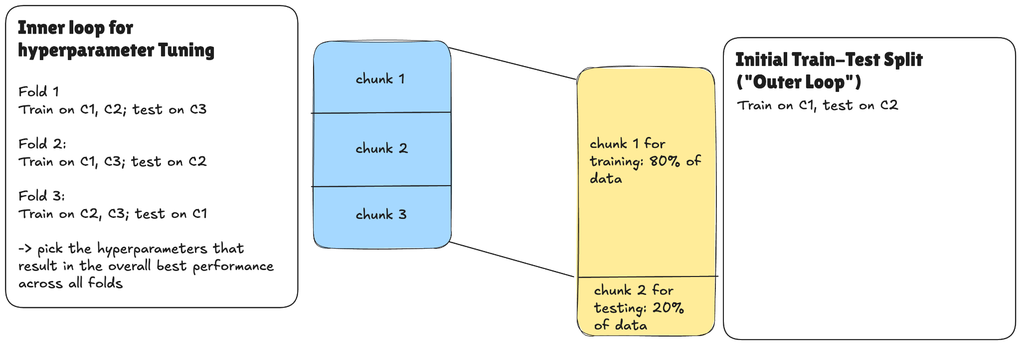
Assignment 2
Full starting
dataset

Slide 49
Q&A
"Questions?"

